Slide 1
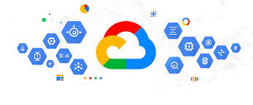
GOOGLE CLOUD

Slide 2
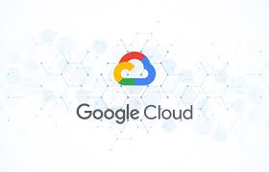
Google Cloud is like a big online toolbox offered by Google to help businesses and developers store, manage, and run their data and applications on the internet. Instead of having to own physical servers or other equipment, companies can rent powerful computing resources from Google over the internet.

Slide 3
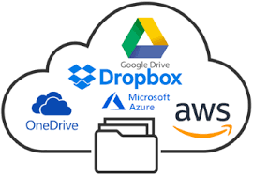
Files saved on online platforms like Google Drive, Microsoft OneDrive, or Dropbox. Cloud storage provides access from any device with an internet connection, easy sharing, and backup options.
Cloud storage advantages include remote access, security features, and ease of sharing with others.

Slide 4
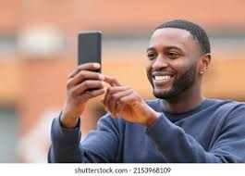
KEY THINGS GOOGLE CLOUD CAN DO :
Imagine you take pictures with your camera and want to store them. You can keep them in a cloud storage, which is like a special place in the sky for your pictures.
You don’t have to worry about losing your photos because they’re safe in the cloud!

Slide 5
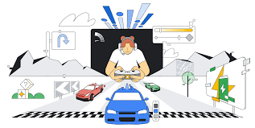
When you play games or use apps, they run on computers. Google Cloud has huge, super-fast computers that can run apps for you.
If your app needs more power, Google Cloud can give it more “power” (just like turning up the volume on a speaker).

Slide 6
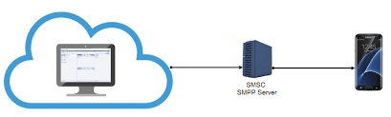
When you send a message to a friend, you're sharing information. Google Cloud helps share information between computers quickly.
If you're playing an online game with friends, Google Cloud makes sure the game keeps running smoothly by sharing info between players.

Slide 7
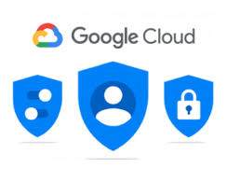
Imagine if someone tried to take your toys or mess with them. Google Cloud has guards that keep everything safe. Only the people who are allowed can get your stuff.
It’s like having a lock on your toy box that only you and your friends can open!

Slide 8

Why is Google Cloud Cool?

Slide 9

No Need for Big Computers: You don’t need to have a huge computer or a big room full of stuff to make things work. Google Cloud does all that for you.
Works Everywhere: If you’re on a beach, in a classroom, or at home, you can still get your things from the cloud.
It Grows With You: If your game, app, or website gets super popular, Google Cloud can help you make it bigger without you doing extra work.

Slide 10
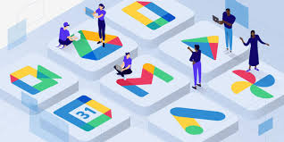
HOW TO USE IT?
Sign Up for Google Cloud using your Google account.
Create a Project — your workspace for all your work.
Store Files — upload photos, videos, or anything you want to keep safe.

Slide 11
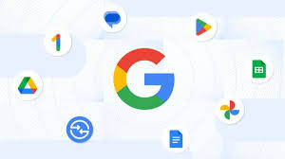
Run Apps — upload an app and let Google Cloud run it for you.
Experiment with AI — have fun using smart tools that help your apps recognize things like pictures or text.
Monitor — check how your stuff is doing and make changes if you need.

